Slide 1
Priority Queue and Heap

Slide 2
PRIORITY QUEUE

Slide 3
Priority Queue
Normal Queue: (Consider the values as age)
Priority Queue:
70
91
9
1
90
20
15
80
12

Slide 4
Priority Queue
Priority Queue: (Priority given to the seniors)
10

Slide 5
Priority Queue
Priority Queue: (Priority given to the seniors)
80
10

Slide 6
Priority Queue
Priority Queue: (Priority given to the seniors)
10
80

Slide 7
Priority Queue
Priority Queue: (Priority given to the seniors)
9
10
80

Slide 8
Priority Queue
Priority Queue: (Priority given to the seniors)
50
9
10
100

Slide 9
Priority Queue
Priority Queue: (Priority given to the seniors)
9
10
50
80

Slide 10
Priority Queue
Priority Queue: (Priority given to the seniors)
5
9
10
50
80

Slide 11
Priority Queue
Priority Queue: (Priority given to the seniors)
8
5
9
10
50
80

Slide 12
Priority Queue
Priority Queue: (Priority given to the seniors)
5
8
9
10
50
80

Slide 13
Priority Queue
Priority Queue: (Priority given to the seniors)
90
5
8
9
10
50
80

Slide 14
Priority Queue
Priority Queue: (Priority given to the seniors)
5
8
9
10
50
80
90

Slide 15
Applications of Priority Queue
Line-up of Incoming Planes at Airport
VIP Planes
Commercial Planes
Emergency Planes
Operating Systems Priority Queues
Alarm clock app
Messenger app

Slide 16
BINARY HEAP

Slide 17
Binary Heaps
The (binary) heap data structure is an array object that can be viewed as a complete binary tree.
Each node of the tree corresponds to an element of the array that stores the value in the node.
The tree is completely filled on all levels except possibly the lowest, where it is filled from the left up to a point.
Despite the fact that it is in fact an array.
We will imagine the entire data structure to be a tree.

Slide 18
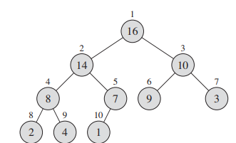
Binary Heaps
How can we visualize this array as a complete binary tree?
1 | 2 | 3 | 4 | 5 | 6 | 7 | 8 | 9 | 10
16 | 14 | 10 | 8 | 7 | 9 | 3 | 2 | 4 | 1

Slide 19
Binary Heaps
Some basic variables and functions of a heap:
A.heap-size
A.length
PARENT(i)
LEFT(i)
RIGHT(i)
Let us observe the array again
1 | 2 | 3 | 4 | 5 | 6 | 7 | 8 | 9 | 10
16 | 14 | 10 | 8 | 7 | 9 | 3 | 2 | 4 | 1

Slide 20
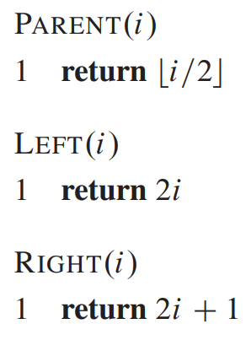
Binary Heaps
Question: Who is the parent of the 7th array element?
Answer:
We can draw the tree and find out
We can use these functions and determine directly
1 | 2 | 3 | 4 | 5 | 6 | 7 | 8 | 9 | 10
16 | 14 | 10 | 8 | 7 | 9 | 3 | 2 | 4 | 1

Slide 21
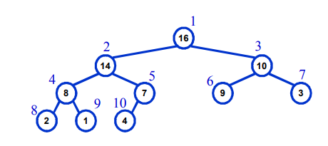
Max Heap and Min Heap
Max-Heaps
Satisfies the heap property: A[Parent(i)] >= A[i] for all nodes i > 1
The value of a node is at most the value of its parent
The largest element in a max-heap is stored at the root
Where is the smallest element ?
Ans: At one of the leaves [leaf indices are n/2+1 to n]

Slide 22
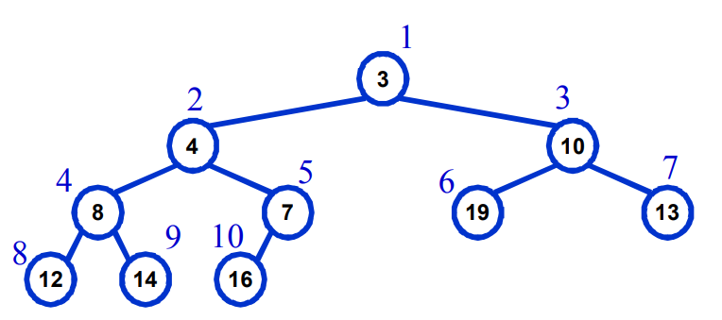
Max Heap and Min Heap
Min-Heaps
Satisfies the heap property: A[Parent(i)] <= A[i] for all nodes i > 1
The value of a node is at least the value of its parent
The smallest element in a max-heap is stored at the root
Where is the largest element ?
Ans: At one of the leaves [leaf indices are n/2+1 to n]

Slide 23
Important Functions of Max Heap
MAX-HEAPIFY –
O(lg n) time
Tries to make the array into a heap
BUILD-MAX-HEAP
O(n) time
Converts an array into a heap
HEAPSORT
O (n lg n) time
Another sorting algorithm
Makes use of the concept of heap
Priority Queue functions
MAX-HEAP-INSERT
HEAP-EXTRACT-MAX
HEAP-INCREASE-KEY
HEAP-MAXIMUM
run in O(lg n) time

Slide 24
MAX HEAPIFY
Tries to make the array into a max heap
(parent value>= child value)
MaxHeapify(A,index)
1
16
3
1 | 2 | 3 | 4 | 5 | 6 | 7 | 8 | 9 | 10
16 | 4 | 10 | 14 | 7 | 9 | 3 | 2 | 8 | 1
2
4
10
4
5
6
7
14
7
9
3
8
9
10
2
8
1

Slide 25
MAX HEAPIFY
Tries to make the array into a max heap
(parent value>= child value)
MaxHeapify(A,index)
1 | 2 | 3 | 4 | 5 | 6 | 7 | 8 | 9 | 10
16 | 4 | 10 | 14 | 7 | 9 | 3 | 2 | 8 | 1
1
16
3
2
4
10
4
5
6
7
14
7
9
3
8
9
10
2
8
1

Slide 26
MAX HEAPIFY
Tries to make the array into a max heap
(parent value>= child value)
MaxHeapify(A,index)
1 | 2 | 3 | 4 | 5 | 6 | 7 | 8 | 9 | 10
16 | 4 | 10 | 14 | 7 | 9 | 3 | 2 | 8 | 1
1
16
3
How the function works:
It is applied on an index.
It checks if the parent is greater than the child
If the parent is greater, return.
If the child is greater, then swap values with child
Run the function on the child (recursively)
2
4
10
4
5
6
7
14
7
9
3
8
9
10
2
8
1

Slide 27
MAX HEAPIFY
Tries to make the array into a max heap
(parent value>= child value)
MaxHeapify(A,index)
1 | 2 | 3 | 4 | 5 | 6 | 7 | 8 | 9 | 10
16 | 4 | 10 | 14 | 7 | 9 | 3 | 2 | 8 | 1
1
16
MaxHeapify(A,2)
3
How the function works:
It is applied on an index.
It checks if the parent is greater than the child
If the parent is greater, return.
If the child is greater, then swap values with child
Run the function on the child (recursively)
2
4
10
4
5
6
7
14
7
9
3
8
9
10
2
8
1

Slide 28
MAX HEAPIFY
Tries to make the array into a max heap
(parent value>= child value)
MaxHeapify(A,index)
1 | 2 | 3 | 4 | 5 | 6 | 7 | 8 | 9 | 10
16 | 4 | 10 | 14 | 7 | 9 | 3 | 2 | 8 | 1
1
16
MaxHeapify(A,2)
3
How the function works:
It is applied on an index.
It checks if the parent is greater than the child
If the parent is greater, return.
If the child is greater, then swap values with child
Run the function on the child (recursively)
2
4
10
4
5
6
7
Largest
14
7
9
3
8
9
10
2
8
1

Slide 29
MAX HEAPIFY
Tries to make the array into a max heap
(parent value>= child value)
MaxHeapify(A,index)
1 | 2 | 3 | 4 | 5 | 6 | 7 | 8 | 9 | 10
16 | 4 | 10 | 14 | 7 | 9 | 3 | 2 | 8 | 1
1
16
MaxHeapify(A,2)
3
How the function works:
It is applied on an index.
It checks if the parent is greater than the child
If the parent is greater, return.
If the child is greater, then swap values with child
Run the function on the child (recursively)
2
4
10
4
5
6
7
Largest
14
7
9
3
8
9
10
2
8
1

Slide 30
MAX HEAPIFY
Tries to make the array into a max heap
(parent value>= child value)
MaxHeapify(A,index)
1 | 2 | 3 | 4 | 5 | 6 | 7 | 8 | 9 | 10
16 | 4 | 10 | 14 | 7 | 9 | 3 | 2 | 8 | 1
1
16
MaxHeapify(A,2)
3
How the function works:
It is applied on an index.
It checks if the parent is greater than the child
If the parent is greater, return.
If the child is greater, then swap values with child
Run the function on the child (recursively)
2
4
10
4
5
6
7
14
7
9
3
8
9
10
2
8
1

Slide 31
MAX HEAPIFY
Tries to make the array into a max heap
(parent value>= child value)
MaxHeapify(A,index)
1 | 2 | 3 | 4 | 5 | 6 | 7 | 8 | 9 | 10
16 | 14 | 10 | 4 | 7 | 9 | 3 | 2 | 8 | 1
1
16
MaxHeapify(A,2)
3
How the function works:
It is applied on an index.
It checks if the parent is greater than the child
If the parent is greater, return.
If the child is greater, then swap values with child
Run the function on the child (recursively)
2
14
10
4
5
6
7
4
7
9
3
8
9
10
2
8
1

Slide 32
MAX HEAPIFY
Tries to make the array into a max heap
(parent value>= child value)
MaxHeapify(A,index)
1 | 2 | 3 | 4 | 5 | 6 | 7 | 8 | 9 | 10
16 | 14 | 10 | 4 | 7 | 9 | 3 | 2 | 8 | 1
1
16
3
How the function works:
It is applied on an index.
It checks if the parent is greater than the child
If the parent is greater, return.
If the child is greater, then swap values with child
Run the function on the child (recursively)
2
14
10
MaxHeapify(A,4)
4
5
6
7
4
7
9
3
8
9
10
2
8
1
Largest

Slide 33
MAX HEAPIFY
Tries to make the array into a max heap
(parent value>= child value)
MaxHeapify(A,index)
1 | 2 | 3 | 4 | 5 | 6 | 7 | 8 | 9 | 10
16 | 14 | 10 | 4 | 7 | 9 | 3 | 2 | 8 | 1
1
16
3
How the function works:
It is applied on an index.
It checks if the parent is greater than the child
If the parent is greater, return.
If the child is greater, then swap values with child
Run the function on the child (recursively)
2
14
10
MaxHeapify(A,4)
4
5
6
7
4
7
9
3
8
9
10
2
8
1

Slide 34
MAX HEAPIFY
Tries to make the array into a max heap
(parent value>= child value)
MaxHeapify(A,index)
1 | 2 | 3 | 4 | 5 | 6 | 7 | 8 | 9 | 10
16 | 14 | 10 | 8 | 7 | 9 | 3 | 2 | 4 | 1
1
16
3
How the function works:
It is applied on an index.
It checks if the parent is greater than the child
If the parent is greater, return.
If the child is greater, then swap values with child
Run the function on the child (recursively)
2
14
10
MaxHeapify(A,4)
4
5
6
7
8
7
9
3
8
9
10
2
4
1

Slide 35
MAX HEAPIFY
Tries to make the array into a max heap
(parent value>= child value)
MaxHeapify(A,index)
1 | 2 | 3 | 4 | 5 | 6 | 7 | 8 | 9 | 10
16 | 14 | 10 | 8 | 7 | 9 | 3 | 2 | 4 | 1
1
16
3
How the function works:
It is applied on an index.
It checks if the parent is greater than the child
If the parent is greater, return.
If the child is greater, then swap values with child
Run the function on the child (recursively)
2
14
10
4
5
6
7
8
7
9
3
8
9
10
2
4
1
MaxHeapify(A,9)

Slide 36
Let us write the function for Max Heapify

Slide 37
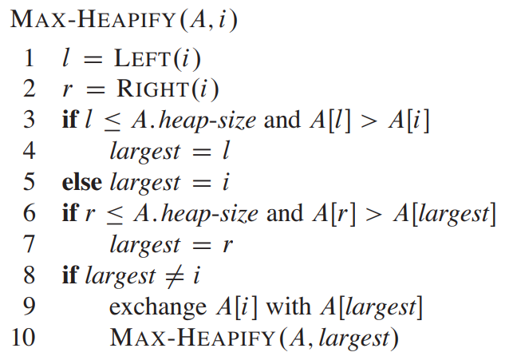
Let us write the function for Max Heapify

Slide 38
Max Heapify
It is TRYING to make the array into a heap
But it may not fully succeed
Let us consider the following example

Slide 39
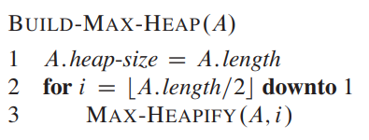
Build Max Heap
Converts an array into a heap

Slide 40
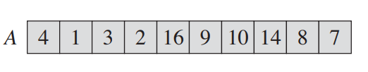
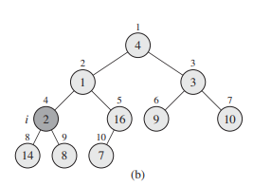
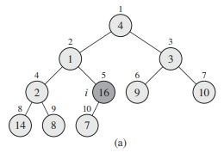
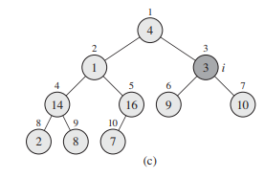
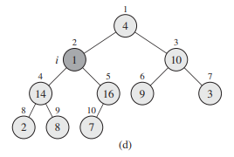
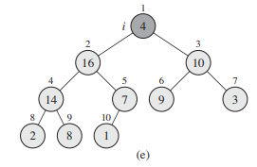
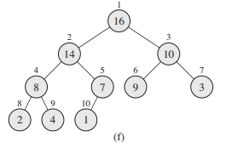
Build Max Heap
Consider the following array

Slide 41
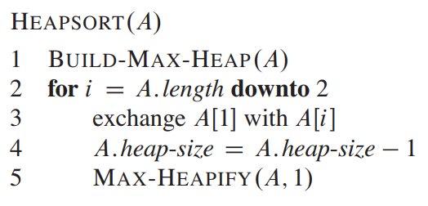
Heap Sort

Slide 42
Let us Run Heap Sort At First

Slide 43
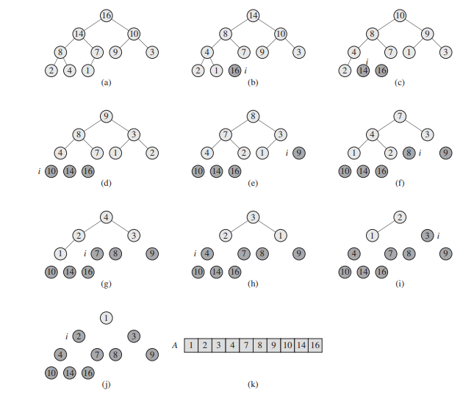
Let us Run Heap Sort At First

Slide 44
Time Complexity Analysis-Max Heapify
Max Heapify
Fixing up relationships among the elements A[i], A[l], and A[r] takes Θ(1) time
If the heap at i has n elements, at most how many elements can the subtrees at l or r have?
Answer: 2n/3 (worst case: bottom row half full)
So time taken by Heapify() is given by
T(n) ≤ T(2n/3) + Θ(1)
16
l
r
14
10
8
7
9
3
2
4
1
5

Slide 45
Time Complexity Analysis-Max Heapify
So we have
T(n) ≤ T(2n/3) + Θ(1)
Solving the recurrence, we have
T(n) = O(lg n)
Thus, Heapify() takes O(h) time for a node at height h

Slide 46
Time Complexity Analysis-Build Max Heap
We can compute a simple upper bound on the running time of BUILD-MAXHEAP as follows.
Each call to MAX-HEAPIFY costs O(lg n) time, and BUILDMAX-HEAP makes O(n) such calls.
Thus, the running time is O(n lg n).

Slide 47
Time Complexity Analysis-Heap Sort
The HEAPSORT procedure takes time O(n lg n)
since the call to BUILD-MAXHEAP takes time O(n)
Each of the n - 1 calls to MAX-HEAPIFY takes time O(lg n)

Slide 48
Thank You

